Slide 1

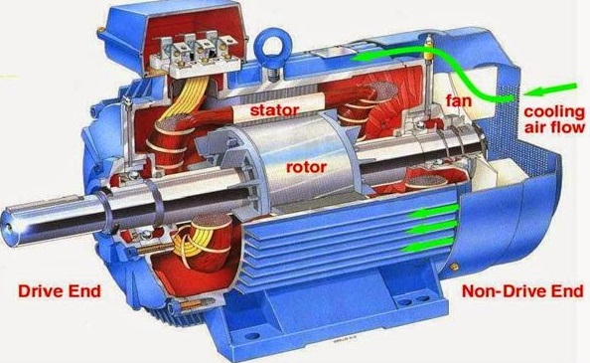
7.4 Disadvantages of Induction Motors
Notes:
Let’s look at some of the major disadvantages of induction motors, especially when compared to other motor types like DC and synchronous motors.

Slide 2
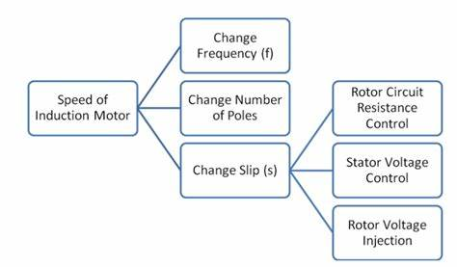
7.4 Disadvantages of Induction Motors
1. Poor Speed Control:
Speed regulation is difficult and imprecise, especially when compared to DC motors, which allow smooth and wide-range speed control using simple methods.
Notes:
First, we have poor speed control. Induction motors, especially squirrel cage types, are not easy to control when it comes to speed. If you need variable speed, you usually have to install an expensive variable frequency drive. This is quite limiting compared to DC motors, which offer simple and effective speed control using just a variable voltage or resistor.

Slide 3
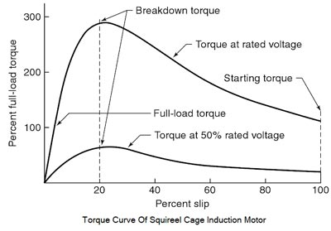
7.4 Disadvantages of Induction Motors
2. Low Starting Torque (in squirrel cage motors):
Squirrel cage induction motors have relatively low starting torque, especially when compared to wound-rotor motors or DC series motors, which are better suited for heavy-starting loads.
Notes:
Second, they offer low starting torque, particularly in squirrel cage motors. If you're dealing with loads that require a strong push at startup—like in cranes or lifts—this type of motor may struggle. In contrast, DC series motors or wound rotor induction motors provide much better torque from standstill.

Slide 4
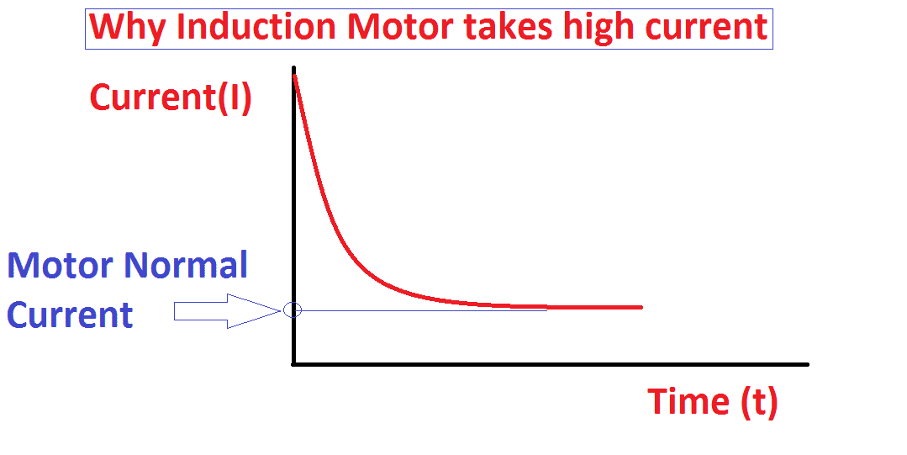
7.4 Disadvantages of Induction Motors
3. High Starting Current:
They draw high inrush current during startup, especially when compared to synchronous motors, which can be designed with controlled startup mechanisms. This may strain the power system or require extra protection.
Notes:
Third, induction motors have a high starting current. When starting up, they draw a large amount of current—several times their rated value. This can place stress on electrical systems and often requires special starting equipment or protection systems. Compared to synchronous motors, which can have more controlled startup mechanisms, this is a drawback.

Slide 5
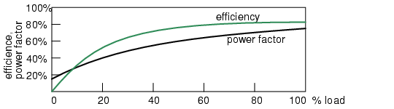
7.4 Disadvantages of Induction Motors
4. Poor Power Factor at Light Loads:
The power factor decreases significantly under light loads, especially when compared to synchronous motors, which can operate at or even correct the power factor.
Notes:
Fourth, the power factor drops significantly at light loads. This is especially problematic in energy-conscious systems. Induction motors lag more as the load decreases, whereas synchronous motors can even help correct the power factor if needed.

Slide 6
7.4 Disadvantages of Induction Motors
5. Lower Efficiency at Light Loads:
Induction motors are less efficient under low load conditions, especially when compared to DC motors, which maintain better efficiency across a wider load range.
Notes:
Fifth, their efficiency drops off at low load conditions. They run best at or near full load, but when lightly loaded, their efficiency suffers. DC motors, in many cases, maintain better performance even when not fully loaded.

Slide 7
7.4 Disadvantages of Induction Motors
1. Poor Speed Control: 2. Low Starting Torque (in squirrel cage motors): 3. High Starting Current: 4. Poor Power Factor at Light Loads: 5. Lower Efficiency at Light Loads:
Notes:
So in summary, while induction motors are popular for their ruggedness and simplicity, these are just some of the key disadvantages to be aware of. There are certainly other limitations, depending on the application, but these are the most commonly encountered issues in the field."

